Slide 1







C Loops
Repeating Code Multiple Times
Programming with C
SoftUni Team
Technical Trainers
Software University
http://softuni.bg

Slide 2


Table of Contents
What is a Loop?
Loops in C
while loops
do … while loops
for loops
Special loop operators
break, continue, goto
Nested loops

Slide 3

Loop: Definition
A loop is a control statement that repeats the execution of a block of statements
May execute a code block fixed number of times
May execute a code block while given condition holds
Loops that never end are called infinite loops
while (condition)
{
statements;
}

Slide 4

Using while(…) Loop
Repeating a Statement While Certain Condition Holds

Slide 5
How To Use While Loop?
The simplest and most frequently used loop
The repeat condition
Returns a integer result of 0 or 1
Also called loop condition
while (condition)
{
statements;
}

Slide 6
While Loop: How It Works?
condition
false
true
statement

Slide 7
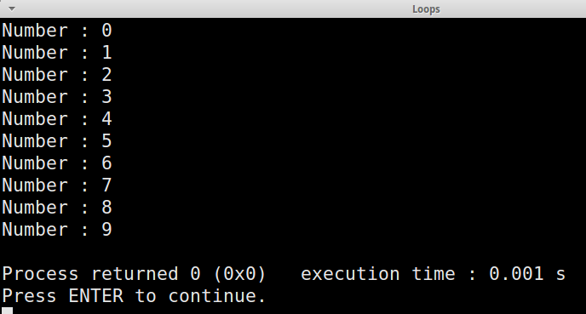
While Loop – Example
int counter = 0;
while (counter < 10)
{
printf("Number : %d\n", counter);
counter++;
}

Slide 8

while(…) Loop
Examples

Slide 9
Sum 1..N – Example
Calculate and print the sum of the first N natural numbers
int n;
printf("n = ");
scanf("%d", &n);
int number = 1, sum = 1;
printf("The sum 1");
while (number < n)
{
number++;
sum += number ;
printf("+%d", number);
}
printf(" = %d\n", sum);

Slide 10

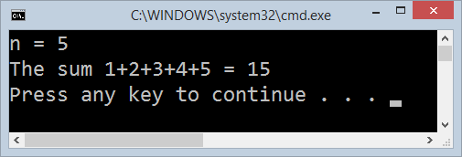
Calculating Sum 1..N
Live Demo

Slide 11

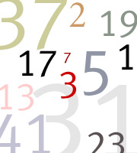
Prime Number Check – Example
printf("Enter a positive integer number: ");
unsigned int number;
scanf("%du", &number);
unsigned int divider = 2;
unsigned int maxDivider = (unsigned int) sqrt(number);
int isPrime = 1;
while (isPrime && (divider <= maxDivider))
{
if ((number % divider) == 0)
{
isPrime = 0;
}
divider++;
}
printf("Prime? %s", isPrime ? "yes" : "no");

Slide 12
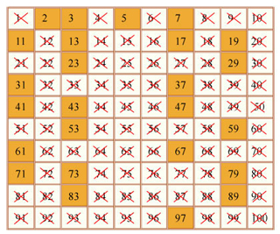
Checking Whether a Number Is Prime
Live Demo

Slide 13
Using the break Operator
The break operator exits the inner-most loop
int n;
scanf("%d", &n);
// Calculate n! = 1 * 2 * ... * n
int result = 1;
while (1)
{
if (n == 1)
break;
result *= n;
n--;
}
printf("n! = %d", result);

Slide 14
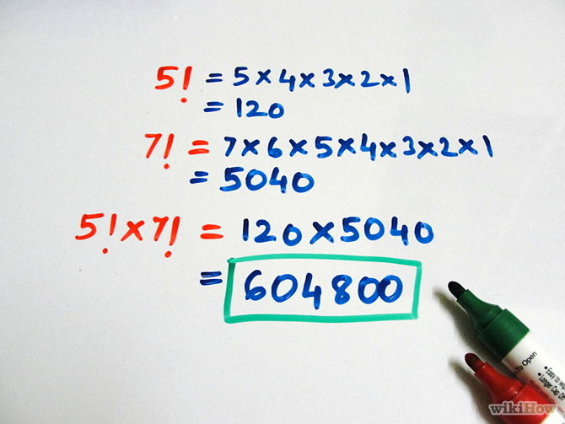
Calculating Factorial
Live Demo

Slide 15

do { … } while (…) Loop

Slide 16

Using Do-While Loop
Another classical loop structure is:
The block of statements is repeated
While the boolean loop condition holds
The loop is executed at least once
do
{
statements;
}
while (condition);

Slide 17
Do-While Statement: How It Works?
statements
true
condition
false

Slide 18

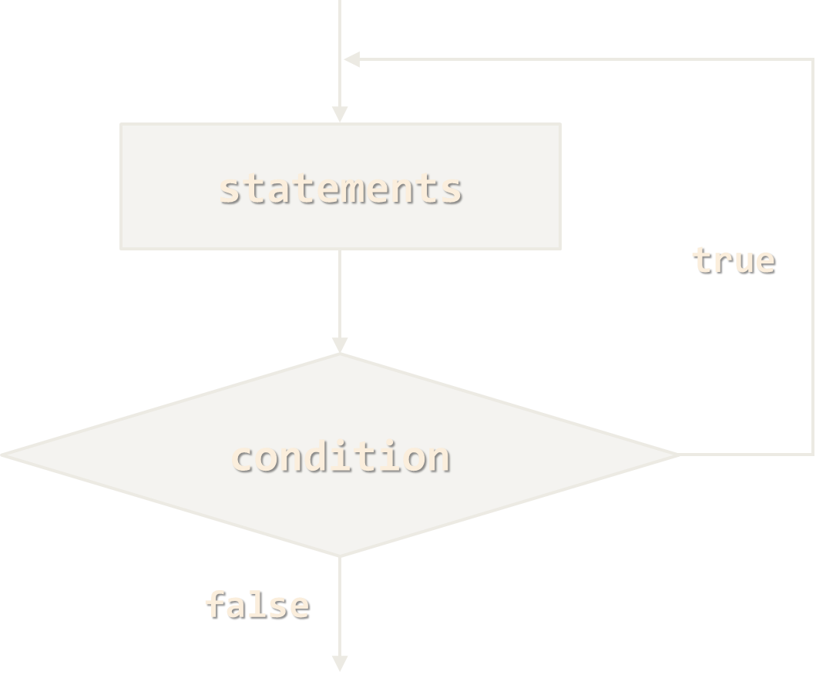
do { … } while (…)
Examples

Slide 19
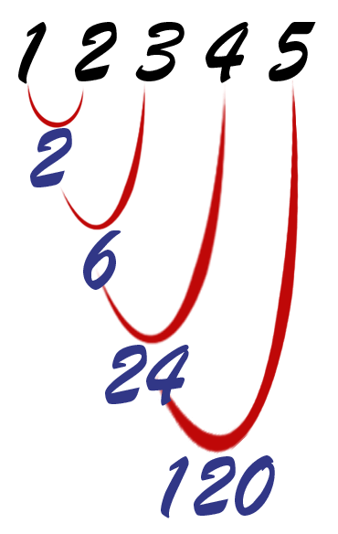
Calculating N Factorial – Example
int n;
scanf("%d", &n);
int factorial = 1;
do
{
factorial *= n;
n--;
}
while (n > 0);
printf("n! = %d", factorial);

Slide 20
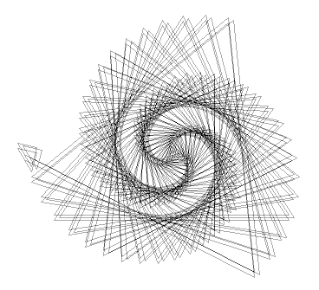
Factorial (do ... while)
Live Demo

Slide 21
Product of Integers [N..M] – Example
Calculating the product of all integers in the interval [n..m]:
int n, m;
scanf("%d %d", &n, &m);
int number = n;
long product = 1;
do
{
product *= number;
number++;
}
while (number <= m);
printf("product[%d..%d] = %ld", n, m, product);

Slide 22
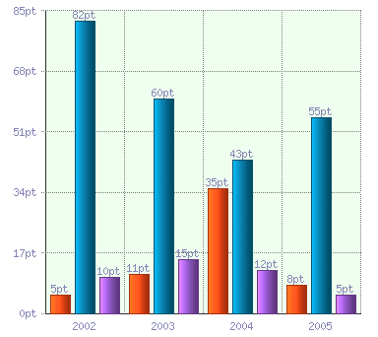
Product of the Integers in the Interval [n..m]
Live Demo

Slide 23

for Loops

Slide 24
For Loops
The typical for loop syntax is:
Consists of
Initialization statement
Boolean test expression
Update statement
Loop body block
for (initialization; test; update) { statements; }

Slide 25
The Initialization Expression
for (int number = 0; ...; ...) { // Can use number here } // Cannot use number here (out of scope)
The initialization expression
Executed once, just before the loop is entered
Like it is out of the loop, just before it
Typically used to declare a counter variable

Slide 26
The Test Expression
for (int number = 0; number < 10; ...) { // Can use number here } // Cannot use number here (out of scope)
The test expression is evaluated before each loop iteration
If true, the loop body is executed
If false, the loop finishes (and the loop body is skipped)
Used as a loop condition

Slide 27
The Update Expression
for (int number = 0; number < 10; number++) { // Can use number here } // Cannot use number here (out of scope)
The update expression
Executed at each iteration after the body of the loop is finished
Typically used to update the loop counter
Can update multiple variables

Slide 28
for-loop Variants
C89 Standard
C99 Standard
int i;
for (i = 0; i < 10; i++) { // ... }
for (int i = 0; i < 10; i++) { // ... }
To use the C99 standard, add the -std=c99 compiler flag, e.g.:
gcc –std=c99 main

Slide 29

for Loop
Examples

Slide 30
Simple for Loop – Example
A simple for-loop to print the numbers 0…9:
for (int number = 0; number < 10; number++)
{
printf("%d\n", number);
}
A simple for-loop to calculate n!:
long factorial = 1;
for (int i = 1; i <= n; i++)
{
factorial *= i;
}

Slide 31
Complex for Loop – Example
A complex for-loop could have several counter variables:
for (int i = 1, sum = 1; i <= 128; i = i * 2, sum += i)
{
printf("i=%d, sum=%d", i, sum);
}
Result:
i=1, sum=1
i=2, sum=3
i=4, sum=7
i=8, sum=15
...

Slide 32

For Loops
Live Demo

Slide 33
N^M – Example
Calculating n to power m (denoted as n^m):
static void Main()
{
int n, m;
scanf("%d %d", &n, &m);
long result = 1;
for (int i = 0; i < m; i++)
{
result *= n;
}
printf("n^m = %d", result);
}

Slide 34

Calculating N^M
Live Demo

Slide 35
Using the continue Operator
continue bypasses the iteration of the inner-most loop
Example: sum all odd numbers in [1…n], not divisors of 7:
int n, sum = 0;
scanf("%d", &n);
for (int i = 1; i <= n; i += 2)
{
if (i % 7 == 0)
{
continue;
}
sum += i;
}
printf("sum = %d", sum);

Slide 36

Using the continue Operator
Live Demo

Slide 37

Nested Loops
Using a Loop Inside a Loop

Slide 38
What Is Nested Loop?
A composition of loops is called a nested loop
A loop inside another loop
for (initialization; test; update)
{
for (initialization; test; update)
{
statements;
}
…
}

Slide 39

Nested Loops
Examples

Slide 40
Triangle – Example
Print the following triangle of numbers:
int n;
scanf("%d", &n);
for (int row = 1; row <= n; row++)
{
for (int column = 1; column <= row; column++)
{
printf("%d ", column);
}
printf("\n");
}
1
1 2
…
1 2 3 … n

Slide 41

Triangle of Numbers
Live Demo

Slide 42
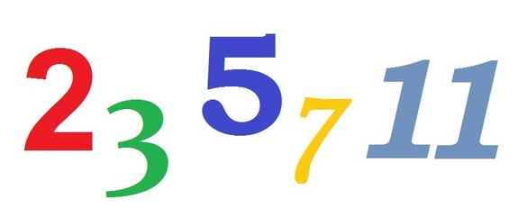
Primes in the Range [N … M] – Example
int n, m;
scanf("%d %d", &n, &m);
for (int number = n; number <= m; number++)
{
int prime = 1;
int divider = 2;
int maxDivider = (int) sqrt(number);
while (divider <= maxDivider)
{
if (number % divider == 0)
{
prime = 0;
break;
}
divider++;
}
if (prime)
printf("%d ", number);
}

Slide 43

Primes in the Range [n, m]
Live Demo

Slide 44
C Jump Statements
Jump statements are:
break, continue, goto
How continue woks?
In while and do-while loops jumps to the test expression
In for loops jumps to the update expression
To exit the most-inner loop use break
To exit from an outer loop use goto with a label
Note: avoid using goto! (it is considered harmful)

Slide 45
C Jump Statements – Example
int outerCounter = 0;
for (int outer = 0; outer < 10; outer++)
{ for (int inner = 0; inner < 10; inner++)
{ if (inner % 3 == 0)
continue; if (outer == 7)
break; if (inner + outer > 9)
goto breakOut; }
outerCounter++;
} breakOut:
Label

Slide 46

Loops: More Examples

Slide 47
Nested Loops – Examples
Print all four digit numbers in format ABCD such that A+B = C+D (known as happy numbers)
Can you improve this algorithm to use only 3 nested loops?
for (int a = 1; a <= 9; a++)
for (int b = 0; b <= 9; b++)
for (int c = 0; c <= 9; c++)
for (int d = 0; d <= 9; d++)
if ((a + b) == (c + d))
printf("%d%d%d%d", a, b, c, d);

Slide 48

Happy Numbers
Live Demo

Slide 49
Nested Loops – Examples
Print all combinations from TOTO 6/49 lottery
Warning: the execution of this code could take a very long time.
int i1, i2, i3, i4, i5, i6;
for (i1 = 1; i1 <= 44; i1++)
for (i2 = i1 + 1; i2 <= 45; i2++)
for (i3 = i2 + 1; i3 <= 46; i3++)
for (i4 = i3 + 1; i4 <= 47; i4++)
for (i5 = i4 + 1; i5 <= 48; i5++)
for (i6 = i5 + 1; i6 <= 49; i6++)
printf("%d %d %d %d %d %d",
i1, i2, i3, i4, i5, i6);

Slide 50

TOTO 6/49
Live Demo

Slide 51

Summary
C supports four types of loops:
while loops
do-while loops
for loops
Nested loops are used to implement more complex logic
The operators continue, break & goto can change the default loop execution behavior

Slide 52








C Programming – Loops
https://softuni.bg/trainings/1212/C-Programming-October-2015

Slide 53
License
This course (slides, examples, demos, videos, homework, etc.) is licensed under the "Creative Commons Attribution-NonCommercial-ShareAlike 4.0 International" license
Attribution: this work may contain portions from
"Programming Basics" course by Software University under CC-BY-SA license

Slide 54






Free Trainings @ Software University
Software University Foundation – softuni.org
Software University – High-Quality Education, Profession and Job for Software Developers
softuni.bg
Software University @ Facebook
facebook.com/SoftwareUniversity
Software University @ YouTube
youtube.com/SoftwareUniversity
Software University Forums – forum.softuni.bg

